Slide 1
Unsupervised learning : Clustering
No labels are provided
Goal
Discover a data structure (groups, patterns)
Challenges
No ground truth
Results validation
Meaning of the discovered groups

Slide 2
Clustering vs Classification
Classification (Supervised) | Clustering (Unsupervised)
Labels are known | No labels available
Learn from examples | Discover hidden structure
Predict categories | Reveal groups

Slide 3
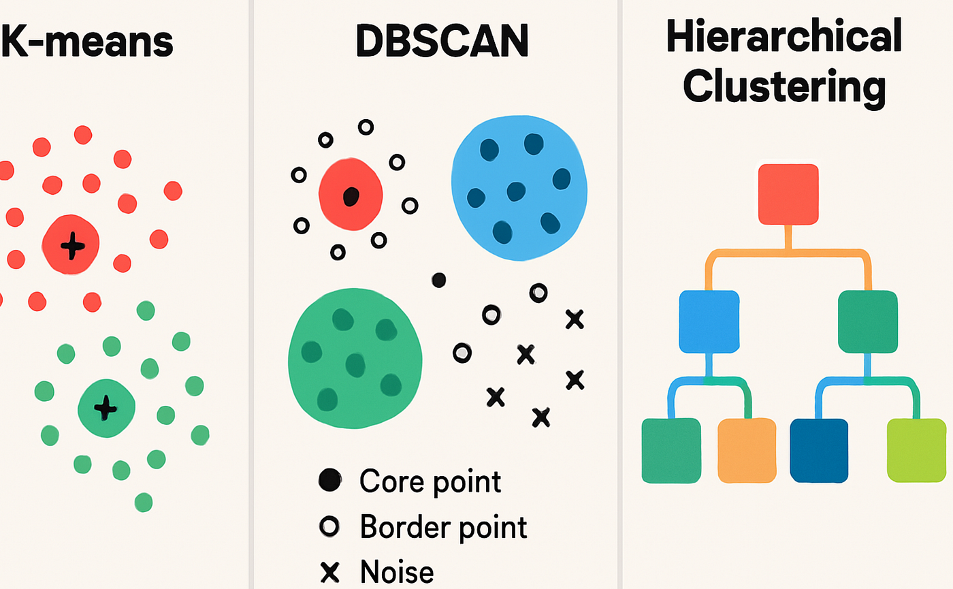
Different ways to cluster data
https://medium.com/@kiranvutukuri/28-clustering-algorithms-k-means-dbscan-and-hierarchical-4fbac2ad0bc0

Slide 4
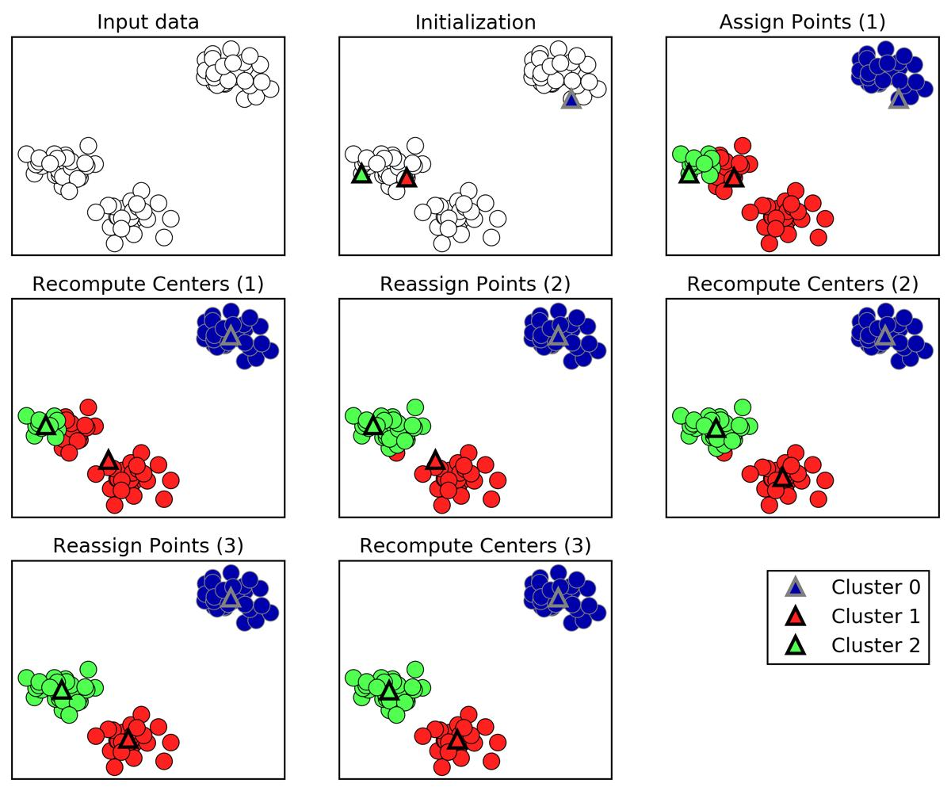
K-means
Choose number of clusters : k
Random initialization of the k centroids
Each data point is assigned to the nearest center
Update centroids by averaging assigned points
Iterate until the centers stop moving
Oleiwi, A.A.H. and Adebayo, A.O., 2019. Data Mining Application Using Clustering Techniques (K-Means Algorithm) In The Analysis Of Student’s Result. Journal of Multidisciplinary Engineering Science Studies, 5(5), pp.2587-2593.

Slide 5
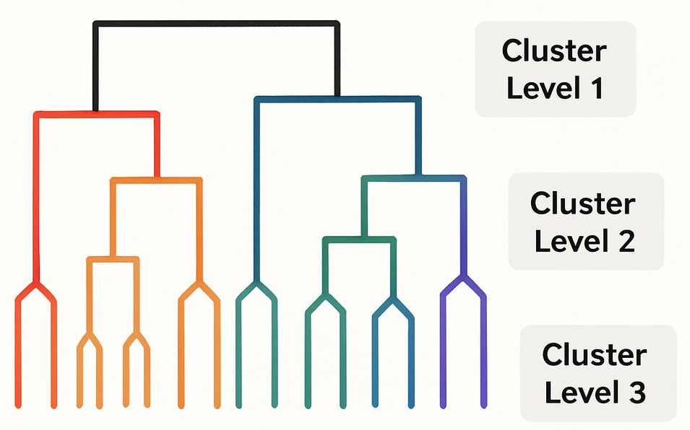
Hierarchical clustering
Every data point starts as a unique cluster
Merge the two closest observations
Repeat
Output : Dendrogram
Decide where to : cut the three – optimal number of clusters to represent the data
Different linking methods will influence which clusters are merged together

Slide 6
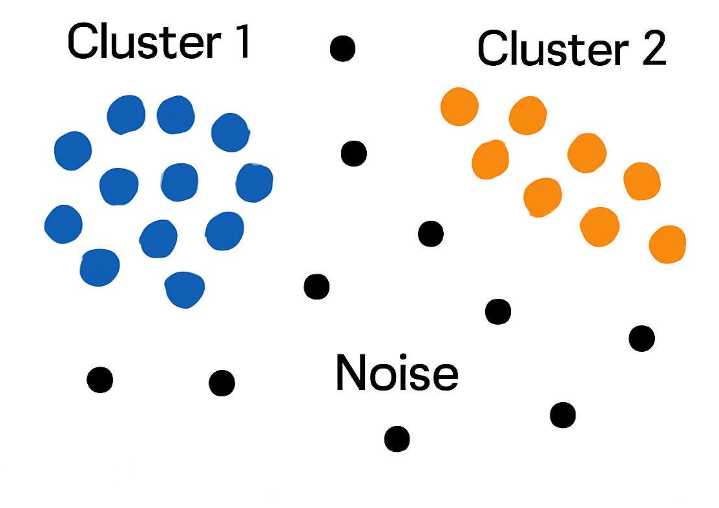
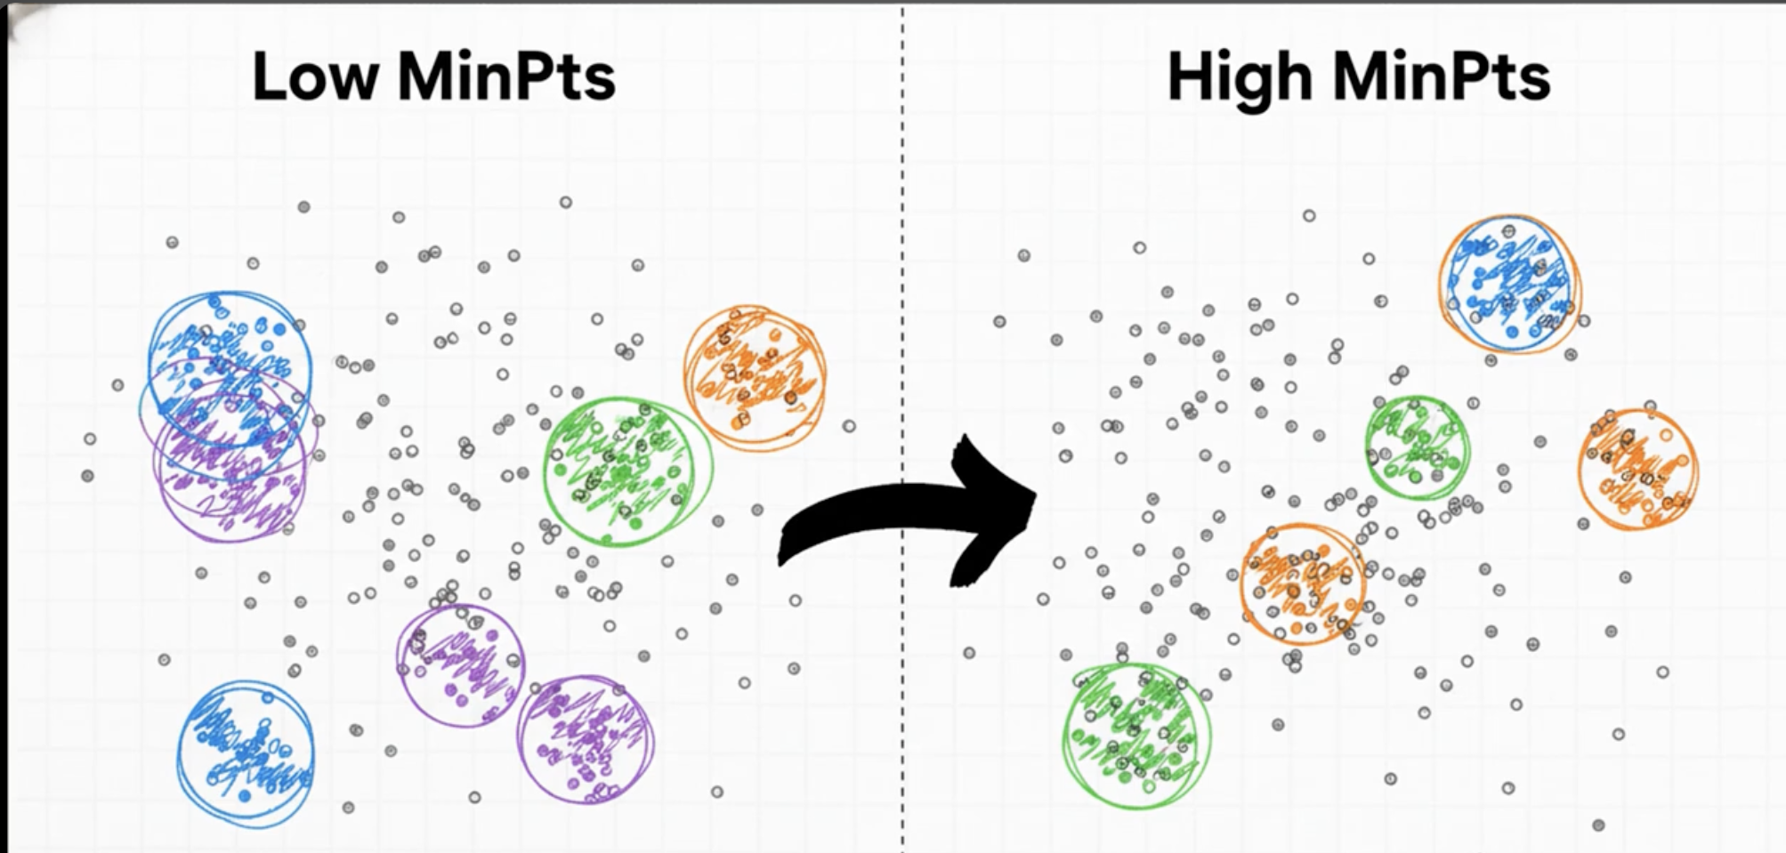
DBSCAN
Defines a cluster as a crowded area of points
A points belongs to a cluster if it as enough neighbors
Sparse point become noise
Parameters to set :
Neighborhood radius
Minimum number of points to form a dense region
ML Course Chapter 10 | Clustering: K-Means, Hierarchical, BIRCH, CURE, DBSCAN

Slide 7
Comparison of the three methods
Criterion | K-means | Hierarchical | DBSCAN
Need to specify the number of clusters (K) | ✅ Yes | ❌ No | ❌ No
Main parameters | K | Linkage method, distance metric | ε (eps), minPts
Sensitivity to parameter selection | Moderate | Moderate | High
Handles irregular cluster shapes | ❌ Poor | ⚠️ Moderate | ✅ Excellent
Handles varying cluster densities | ❌ Poor | ⚠️ Moderate | ❌ Poor
Detects outliers automatically | ❌ No | ❌ No | ✅ Yes
Produces a hierarchy (dendrogram) | ❌ No | ✅ Yes | ❌ No
Computational efficiency | ⭐⭐⭐ Fast | ⭐ Slow | ⭐⭐ Moderate
Interpretability | ⭐⭐⭐ High | ⭐⭐⭐ High | ⭐⭐ Moderate
Best suited for | Compact, spherical clusters | Exploring nested relationships | Arbitrary-shaped clusters with noise

